Slide 1
Introduction to JavaScript
Nisar Ahmed Siddiqui
Lecturer Computer Science
Sukkur IBA University

Slide 2
JavaScript Placement
There are three ways to use javascript in our program.
Inline (Inside the element, in any event value)
In File (Inside Script tag, anywhere in the html document)
External File (A separate JS File)

Slide 3
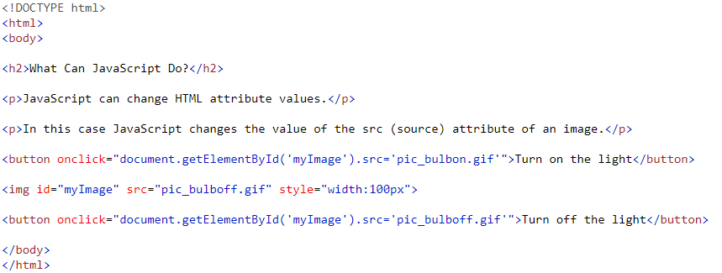
Inline JavaScript
Syntax
Example

Slide 4
In File (<script> tag)
You can place any number of scripts in an HTML document.
Scripts can be placed in the <body>, or in the <head> section of an HTML page, or in both.
Note: Make sure the element which is used in the script, must be available at the time when it is called. You cannot call an element which is not initialized at the time when the script is used
Reference : Read the DOM Elements

Slide 5
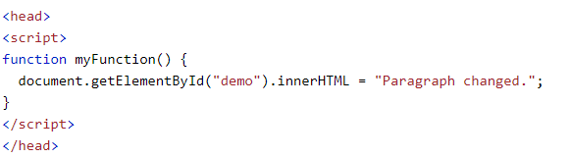
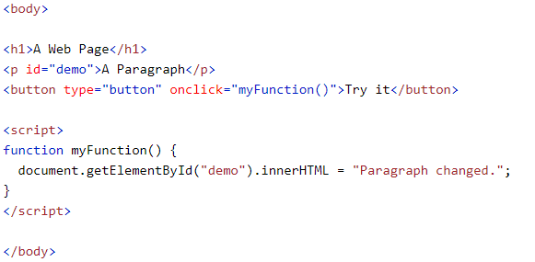
Examples
In Head
In Body

Slide 6
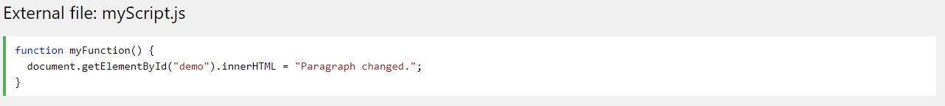
External File
Code in External File (No need to write <script> tag in external file)
Calling External File in HTML
External scripts are practical when the same code is used in many different web pages.
JavaScript files have the file extension .js.
To use an external script, put the name of the script file in the src (source) attribute of a <script> tag

Slide 7

JavaScript Intro
JavaScript is a loosely & dynamically typed language.
JavaScript variables are containers for storing data values, declared with the var keyword:
Notes:
Weakly-typed languages make conversions between unrelated types implicitly; whereas, strongly-typed languages don’t allow implicit conversions between unrelated types.
Python is a strongly-typed language:
var = 21; #type assigned as int at runtime.
var = var + "dot"; #type-error, string and int cannot be concatenated.
print(var);
JavaScript is a weakly-typed language:
value = 21;
value = value + "dot";
console.log(value);

Slide 8
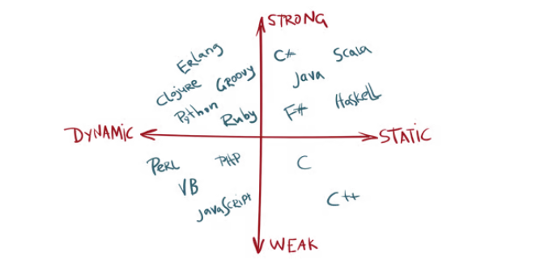
Static Type vs Dynamically Typed
Statically-typed programming languages do type checking
Dynamically-typed languages do type checks at runtime.

Slide 9
Variable Scope
JavaScript has 3 types of scope:
Block scope
Function scope
Global scope

Slide 10
Using let and const (2015)
Before 2015, using the var keyword was the only way to declare a JavaScript variable.
The 2015 version of JavaScript (ES6 - ECMAScript 2015) allows the use of the const keyword to define a variable that cannot be reassigned, and the let keyword to define a variable with restricted scope.
Before ES6 (2015), JavaScript had only Global Scope and Function Scope.
ES6 introduced two important new JavaScript keywords: let and const.
These two keywords provide Block Scope in JavaScript.
Variables declared inside a { } block cannot be accessed from outside the block:

Slide 11

JavaScript Identifiers
All JavaScript variables must be identified with unique names.
These unique names are called identifiers.
Identifiers can be short names (like x and y) or more descriptive names (age, sum, totalVolume).
The general rules for constructing names for variables (unique identifiers) are:
Names can contain letters, digits, underscores, and dollar signs.
Names must begin with a letter
Names can also begin with $ and _ (but we will not use it in this tutorial)
Names are case sensitive (y and Y are different variables)
Reserved words (like JavaScript keywords) cannot be used as names

Slide 12

JavaScript Datatypes
JavaScript variables can hold numbers like 100 and text values like "John Doe".
In programming, text values are called text strings.
JavaScript can handle many types of data, but for now, just think of numbers and strings.
Strings are written inside double or single quotes. Numbers are written without quotes.
If you put a number in quotes, it will be treated as a text string.

Slide 13
Javascript Datatypes
JS has 8 Datatypes
1. String 2. Number 3. Bigint 4. Boolean 5. Undefined 6. Null 7. Symbol 8. Object

Slide 14
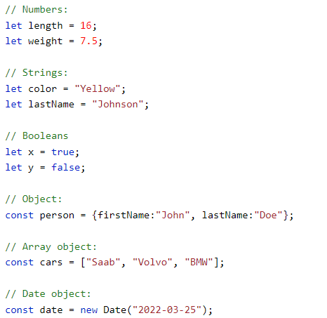
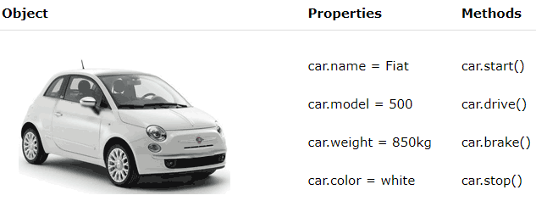
Objects
The object data type can contain:
1. An object 2. An array 3. A date

Slide 15
Javascript conditionals and Loops
Well the conditionals and loops in JavaScript are all same as what we have covered in other courses like c++, java and c#.
So I am skipping it, if you have time go through it.
Reference: Conditionals, Loops

Slide 16

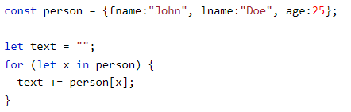
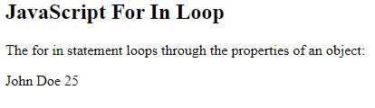
For-in loop
The JavaScript for in statement loops through the properties of an Object:

Slide 17

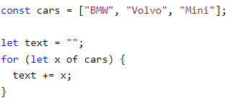
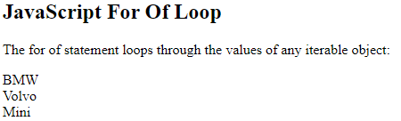
For-of Loop
The JavaScript for of statement loops through the values of an iterable object.
It lets us loop over iterable data structures such as Arrays, Strings, Maps, NodeLists, and more:

Slide 18
JavaScript iterable datatypes
Strings
Arrays
Maps
Sets
WeakMaps
WeakSets
NodeLists

Slide 19

JavaScript Functions
JavaScript function is a block of code designed to perform a particular task.
A JavaScript function is executed when "something" invokes it (calls it)

Slide 20

JavaScript Function Syntax
A JavaScript function is defined with the function keyword, followed by a name, followed by parentheses ().
Function names can contain letters, digits, underscores, and dollar signs (same rules as variables).
The parentheses may include parameter names separated by commas:
(parameter1, parameter2, ...)
The code to be executed, by the function, is placed inside curly brackets: {}

Slide 21
Function Invocation
The code inside the function will execute when "something" invokes (calls) the function:
When an event occurs (when a user clicks a button)
When it is invoked (called) from JavaScript code
Automatically (self invoked)

Slide 22
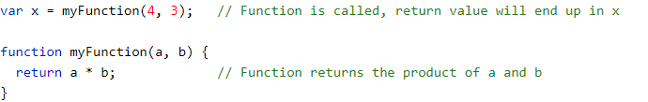
Function Return
When JavaScript reaches a return statement, the function will stop executing.
If the function was invoked from a statement, JavaScript will "return" to execute the code after the invoking statement.
Functions often compute a return value. The return value is "returned" back to the "caller“

Slide 23

JavaScript Arrow Function
Arrow functions were introduced in ES6.
Arrow functions allow us to write shorter function syntax:
Before Arrow:
After Arrow

Slide 24



JavaScript Arrow Function
It gets shorter! If the function has only one statement, and the statement returns a value, you can remove the brackets and the return keyword:
Arrow Function With Parameters:
Arrow Function Without Parentheses:

Slide 25
What About this?
The handling of this is also different in arrow functions compared to regular functions.
In short, with arrow functions there are no binding of this.
In regular functions the this keyword represented the object that called the function, which could be the window, the document, a button or whatever.
With arrow functions the this keyword always represents the object that defined the arrow function.

Slide 26
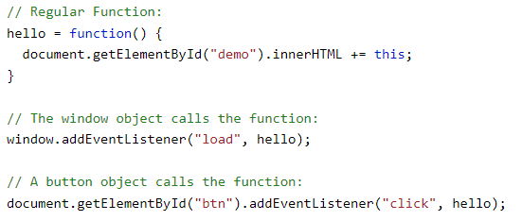
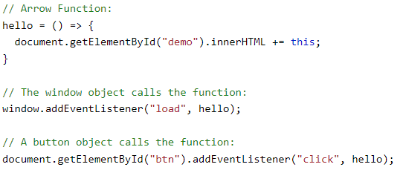
Regular Function vs Arrow Function
Notes:
Code:
// Regular Function: hello = function() { document.getElementById("demo").innerHTML += this; } // The window object calls the function: window.addEventListener("load", hello); // A button object calls the function: document.getElementById("btn").addEventListener("click", hello);
// Arrow Function: hello = () => { document.getElementById("demo").innerHTML += this; } // The window object calls the function: window.addEventListener("load", hello); // A button object calls the function: document.getElementById("btn").addEventListener("click", hello);

Slide 27
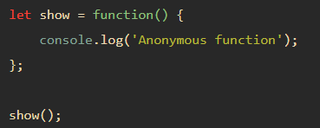
JavaScript anonymous functions
An anonymous function is a function without a name. The following shows how to define an anonymous function:

Slide 28

Anonymous functions
Functions stored in variables do not need function names. They are always invoked (called) using the variable name.
These types of functions are called anonymous functions

Slide 29
Java Arrays - Introduction
Arrays
Data structures of related items
Each element has a position number
Dynamic
Size of an array in JavaScript can be changed (increased) AFTER it is created
Hetrogenius
Arrays in JS are hetrogenius in nature, (much like Structures) you can store all type of elements inside a single array.

Slide 30
Arrays
Arrays in JavaScript
Each element referenced by a number
Start at “zeroth element”: 10 element array has elements: 0,1,2 ,..,8,9
Subscript or index
Accessing a specific element
Name of array
Brackets
Number of element
Arrays know their length
length property

Slide 31
Name of array
c[ 0 ]
-45
c[ 1 ]
6
c[ 2 ]
0
c[ 3 ]
72
c[ 4 ]
1543
c[ 5 ]
-89
c[ 6 ]
0
c[ 7 ]
62
c[ 8 ]
-3
c[ 9 ]
1
Position number (index
or subscript) of the
c[ 10 ]
6453
c
element within array
c[ 11 ]
78
Fig. 11.1 A 12-element array.

Slide 32
Declaring and Allocating Arrays
Arrays in memory
Objects
Operator new
Allocates memory for objects
Dynamic memory allocation operator
var c; ← array declaration c = new Array( 12 ); ← memory allocation
Or
const array_name = [item1, item2, ...];

Slide 33
Using Arrays
Arrays can grow dynamically
Allocate more space as more items are added than originally planned for
Array elements must be initialized explicitly
Default value is “undefined”
for loops convenient fro initialization
Referring to uninitialized elements or elements outside array bounds is an error

Slide 34
Array n1 has five elements.
Array n2 is an empty array.
The for loop initializes the elements in n1 to their subscript numbers (0 to 4).

Slide 35
The for loop adds five elements to Array n2 and initialize each element to its subscript number (0 to 4).
Each function displays the contents of its respective Array in an XHTML table.
The second time function ouputArray is called, variable header gets the value of “Array n2 contains” and variable theArray gets the value of n2.
The first time function ouputArray is called, variable header gets the value of “Array n1 contains” and variable theArray gets the value of n1.

Slide 37
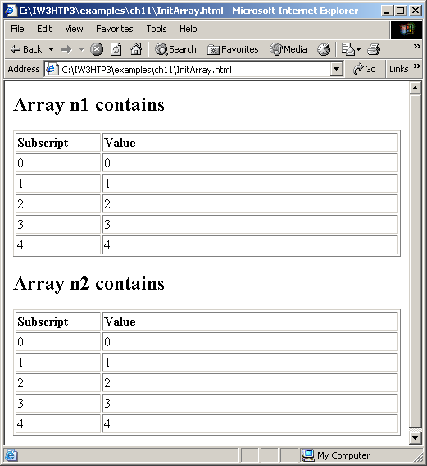
Examples Using Arrays

Slide 38
Examples Using Arrays
for…in statement
Perform an action for each element in an array
Iterates over array elements
Assigns each element to specified variable one at a time
Ignores non-existent elements

Slide 39
SumArray.html (1 of 2)
The for loop sums the values contained in the 10-element integer array called theArray.

Slide 40
SumArray.html (2 of 2)
Variable element is assigned a subscript in the range of 0 up to, but not including, theArray.length.

Slide 41
Multidimensional Arrays
Two-dimensional arrays analogous to tables
Rows and columns
Specify row first, then column
Two subscripts

Slide 42
Multidimensional Arrays
Column 0
Column 1
Column 2
Column 3
Row 0
a[ 0 ][ 0 ]
a[ 0 ][ 1 ]
a[ 0 ][ 2 ]
a[ 0 ][ 3 ]
Row 1
a[ 1 ][ 0 ]
a[ 1 ][ 1 ]
a[ 1 ][ 2 ]
a[ 1 ][ 3 ]
Row 2
a[ 2 ][ 0 ]
a[ 2 ][ 1 ]
a[ 2 ][ 2 ]
a[ 2 ][ 3 ]
Column subscript (or index)
Row subscript (or index)
Array name
Two-dimensional array with three rows and four columns.

Slide 43
Multidimensional Arrays
Declaring and initializing multidimensional arrays
Group by row in square brackets
Treated as arrays of arrays
Creating array b with one row of two elements and a second row of three elements:
var b = [ [ 1, 2 ], [ 3, 4, 5 ] ];

Slide 44
Multidimensional Arrays
Also possible to use new operator
Create array b with two rows, first with five columns and second with three:
var b; b = new Array( 2 ); b[ 0 ] = new Array( 5 ); b[ 1 ] = new Array( 3 );

Slide 45
InitArray3.html (1 of 2)
Array array1 provides six initializers in two rows.
Array array2 provides six initializers in three rows.
Function outputArray displays each array’s elements in a Web page.

Slide 46
InitArray3.html (2 of 2)
Referencing the multidimensional array theArray.

Slide 47
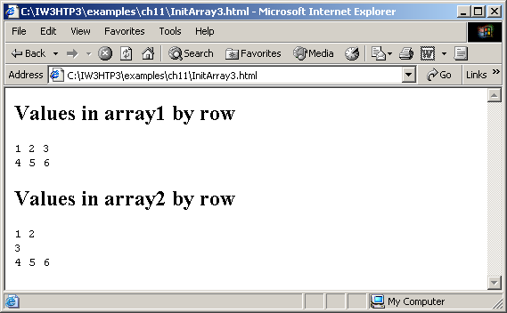
Multidimensional Arrays

Slide 48
JavaScript Iterables & Iterators
Iterable objects are objects that can be iterated over with for..of.
Technically, iterables must implement the Symbol.iterator method.

Slide 49


Some examples of iterables
Iterating Over a String
We can use a for..of loop to iterate over the elements of a string:
Iterating Over an Array

Slide 50
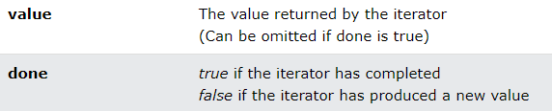
JavaScript Iterators
The iterator protocol defines how to produce a sequence of values from an object.
An object becomes an iterator when it implements a next() method.
The next() method must return an object with two properties:
value (the next value)
done (true or false)

Slide 51
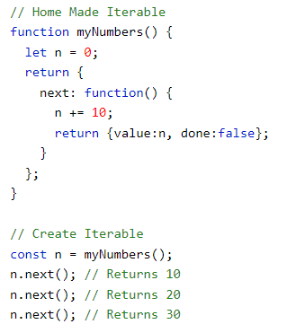

Home made iterable example
This iterable returns never ending: 10,20,30,40,.... Everytime next() is called:

Slide 52
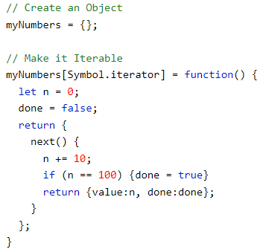

Symbol.iterator
A JavaScript iterable is an object that has a Symbol.iterator.
The Symbol.iterator is a function that returns a next() function.
An iterable can be iterated over with the code:
for (const x of iterable) { }
Now we can use the following code:
Notes:
let range = {
from: 1,
to: 5
};
// 1. call to for..of initially calls this
range[Symbol.iterator] = function() {
// ...it returns the iterator object:
// 2. Onward, for..of works only with the iterator object below, asking it for next values
return {
current: this.from,
last: this.to,
// 3. next() is called on each iteration by the for..of loop
next() {
// 4. it should return the value as an object {done:.., value :...}
if (this.current <= this.last) {
return { done: false, value: this.current++ };
} else {
return { done: true };
}
}
};
};
for (let num of range) {
alert(num); // 1, then 2, 3, 4, 5
}

Slide 53
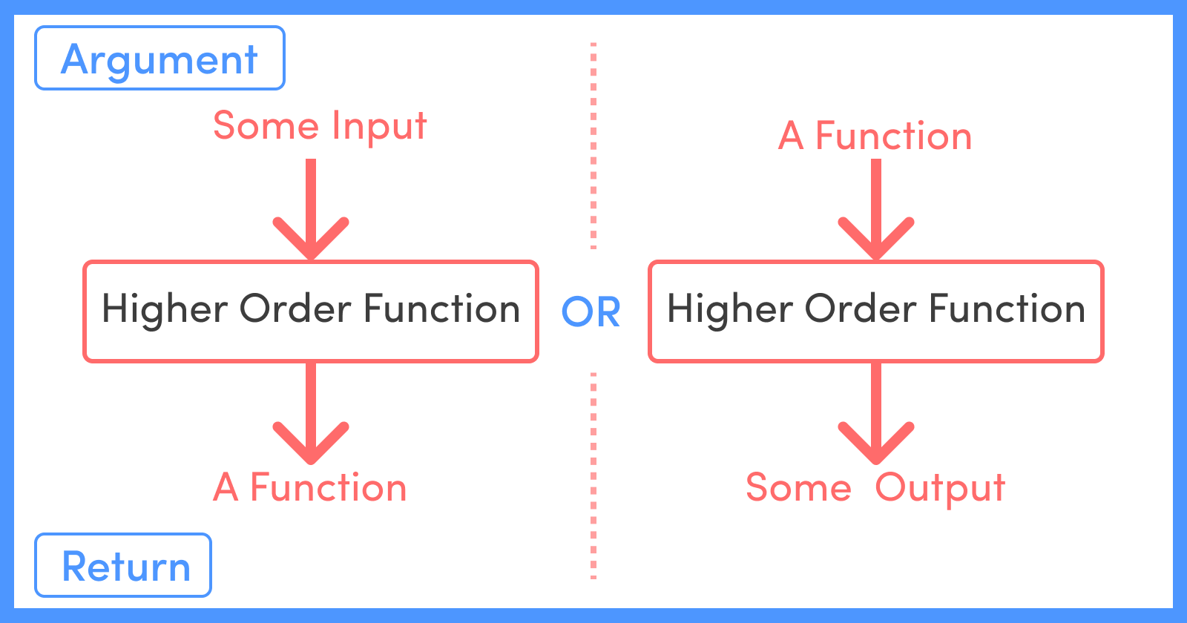
High Order Functions
Higher order functions are functions that operate on other functions, either by taking them as arguments or by returning them
For example, Array.prototype.map, Array.prototype.filter and Array.prototype.reduce are some of the Higher-Order functions built into the language.
Notes:
Sure! Here are some WH questions and answers about higher-order functions in JavaScript:
What are higher-order functions?
Higher-order functions are functions that can take other functions as arguments or return functions as their result. This allows for more flexible and reusable code.
Why use higher-order functions?
Higher-order functions help in writing cleaner, more modular, and reusable code. They enable functional programming techniques, making it easier to manage and manipulate functions and data.
When should you use higher-order functions?
Use higher-order functions when you need to perform operations on collections of data, such as arrays, or when you want to create functions dynamically based on certain conditions.
How do higher-order functions work?
Higher-order functions work by either accepting functions as parameters or returning functions. For example, the map function takes a callback function and applies it to each element in an array, returning a new array with the results.
Who benefits from using higher-order functions?
Developers benefit from using higher-order functions as they make code more concise, readable, and maintainable. They are particularly useful in functional programming and when working with data transformations.
Examples of higher-order functions in JavaScript:
map: Applies a function to each element in an array and returns a new array.
const numbers = [1, 2, 3, 4]; const doubled = numbers.map(num => num * 2); console.log(doubled); // [2, 4, 6, 8]
filter: Creates a new array with all elements that pass the test implemented by the provided function.
const numbers = [1, 2, 3, 4]; const evens = numbers.filter(num => num % 2 === 0); console.log(evens); // [2, 4]
reduce: Executes a reducer function on each element of the array, resulting in a single output value.
const numbers = [1, 2, 3, 4]; const sum = numbers.reduce((acc, num) => acc + num, 0); console.log(sum); // 10
Would you like more detailed examples or explanations on any specific higher-order function?

Slide 54
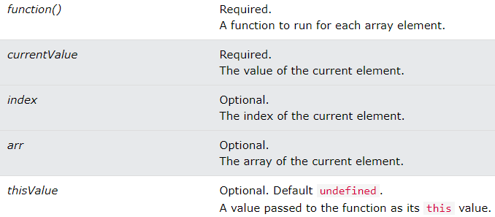
Foreach()
The forEach() method calls a function for each element in an array.
The forEach() method is not executed for empty elements.

Slide 55
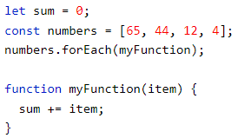
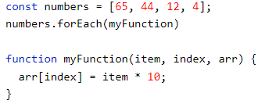
Foreach() (cont…)
Examples:

Slide 56

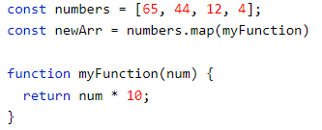
Map()
map() creates a new array from calling a function for every array element.
map() calls a function once for each element in an array.
map() does not execute the function for empty elements.
map() does not change the original array.
Syntax:
Examples:

Slide 57
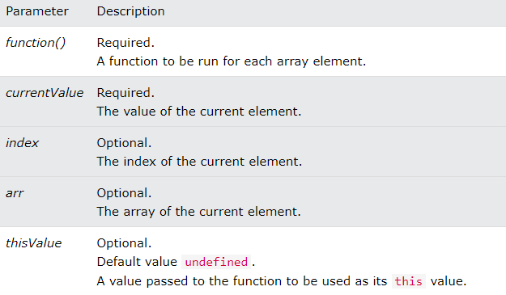
Map() Parameters & description

Slide 58
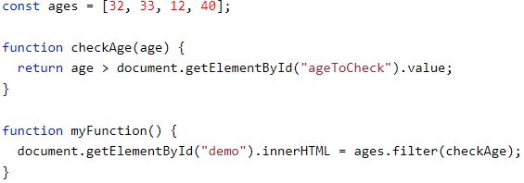
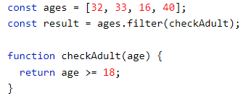
Filter()
The filter() method creates a new array filled with elements that pass a test provided by a function.
The filter() method does not execute the function for empty elements.
The filter() method does not change the original array.
Syntax:
Examples:

Slide 59
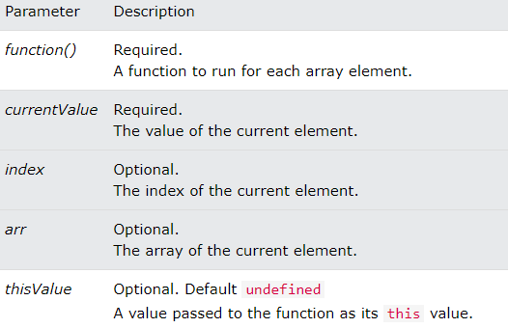
filter() Parameters & description

Slide 60
Find()
The find() method returns the value of the first element that passes a test.
The find() method executes a function for each array element.
The find() method returns undefined if no elements are found.
The find() method does not execute the function for empty elements.
The find() method does not change the original array.
Syntax

Slide 61
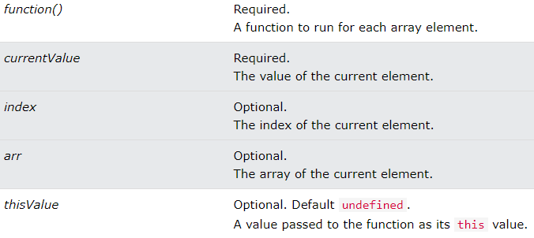
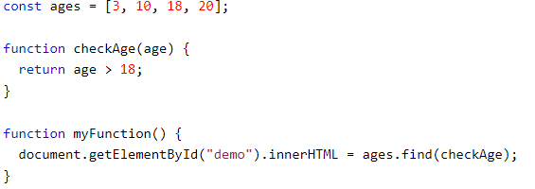
Find() parameters & examples
Parameters Examples:

Slide 62
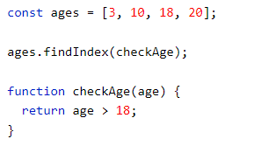
FindIndex()
The findIndex() method executes a function for each array element.
The findIndex() method returns the index (position) of the first element that passes a test.
The findIndex() method returns -1 if no match is found.
The findIndex() method does not execute the function for empty array elements.
The findIndex() method does not change the original array.
Syntax: Example:

Slide 63
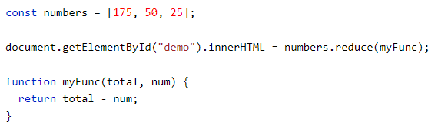
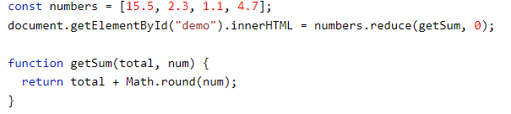
Reduce()
The reduce() method executes a reducer function for array element.
The reduce() method returns a single value: the function's accumulated result.
The reduce() method does not execute the function for empty array elements.
The reduce() method does not change the original array.
Syntax:
Examples:
Notes:
Here's an explanation and differentiation between **higher-order functions**, **callbacks**, and **closures** in JavaScript, along with examples and use cases:
### 1. **Higher-Order Functions**
#### Definition:
A **higher-order function** is a function that either:
- Takes one or more functions as arguments.
- Returns a function as its result.
#### Key Concept:
Higher-order functions are a fundamental part of JavaScript functional programming. They allow more flexibility, reusability, and abstraction.
#### Example:
```javascript
// Higher-order function that takes a callback (a function) as an argument
function higherOrderFunction(callback) {
return callback();
}
// A simple function to pass as a callback
function sayHello() {
return "Hello, World!";
}
// Call the higher-order function
console.log(higherOrderFunction(sayHello)); // Output: Hello, World!
```
#### Use Case:
- **Array methods like `map()`, `filter()`, `reduce()`** are higher-order functions because they take other functions as arguments to process array elements.
Example with `map()`:
```javascript
let numbers = [1, 2, 3];
// `map()` is a higher-order function
let doubled = numbers.map(function(num) {
return num * 2;
});
console.log(doubled); // Output: [2, 4, 6]
```
---
### 2. **Callbacks**
#### Definition:
A **callback** is simply a function that is passed as an argument to another function and is executed after some operation has been completed.
#### Key Concept:
- A callback function can be synchronous (executed immediately) or asynchronous (executed later, often after some task like data fetching is completed).
#### Example (Synchronous Callback):
```javascript
function greet(name, callback) {
console.log("Hello, " + name);
callback();
}
function sayGoodbye() {
console.log("Goodbye!");
}
greet("Alice", sayGoodbye);
// Output:
// Hello, Alice
// Goodbye!
```
#### Example (Asynchronous Callback):
```javascript
function fetchData(callback) {
setTimeout(function() {
console.log("Data fetched");
callback(); // Called after the data is fetched
}, 2000);
}
function processData() {
console.log("Processing data");
}
fetchData(processData);
// Output (after 2 seconds):
// Data fetched
// Processing data
```
#### Use Case:
- **Event handling** (e.g., `onclick` functions), **setTimeout**, and **promises** often use callbacks for tasks that run asynchronously.
---
### 3. **Closures**
#### Definition:
A **closure** is a function that "remembers" the environment (variables and functions) in which it was created, even after that environment no longer exists.
#### Key Concept:
- Closures allow functions to access variables from an outer function scope even after the outer function has finished execution.
#### Example:
```javascript
function outer() {
let counter = 0; // Variable inside outer function
return function inner() { // Inner function forms a closure
counter++; // Inner function can access and modify the counter
console.log(counter);
};
}
const increment = outer();
increment(); // Output: 1
increment(); // Output: 2
```
In this example, the `inner` function maintains access to the `counter` variable even after the `outer` function has finished running. This is due to the closure formed when `inner` is returned.
#### Use Case:
- Closures are useful in scenarios like **data encapsulation** or **maintaining state** across function calls. They can also be used in event listeners, such as when you need to track or store data across multiple events.
Example with encapsulation:
```javascript
function createCounter() {
let count = 0;
return {
increment: function() {
count++;
return count;
},
decrement: function() {
count--;
return count;
}
};
}
const counter = createCounter();
console.log(counter.increment()); // Output: 1
console.log(counter.increment()); // Output: 2
console.log(counter.decrement()); // Output: 1
```
---
### Summary of Differences
| **Concept** | **Definition** | **Example** | **Use Cases** |
|---------------------|-----------------------------------------------------------------------------------------------------------|-------------------------------------------------------------------------------------------------|----------------------------------------------------------------|
| **Higher-Order Function** | A function that takes another function as an argument or returns a function. | `map()`, `filter()`, `reduce()` | Array manipulations, abstracting repetitive tasks |
| **Callback** | A function passed into another function to be executed later (either synchronously or asynchronously). | `setTimeout(callback)` | Event handling, async tasks, API calls |
| **Closure** | A function that retains access to the variables in its outer scope even after the outer function has executed. | Function inside another function that "remembers" outer variables | Data encapsulation, maintaining state between function calls |
### Use Case Example Combining All:
```javascript
// Higher-order function taking a callback
function performOperation(a, b, callback) {
return callback(a, b); // Using the callback function
}
// A callback function
function add(x, y) {
return x + y;
}
// Another callback function
function multiply(x, y) {
return x * y;
}
// Using higher-order function with different callbacks
console.log(performOperation(5, 10, add)); // Output: 15
console.log(performOperation(5, 10, multiply)); // Output: 50
// Example of closure maintaining state
function createCounter() {
let count = 0;
return function() {
count++;
return count;
};
}
const counter = createCounter(); // Closure formed
console.log(counter()); // Output: 1
console.log(counter()); // Output: 2
```
In this example:
- **`performOperation`** is a **higher-order function**.
- **`add`** and **`multiply`** are **callback functions**.
- **`createCounter`** forms a **closure** around the `count` variable, maintaining state across calls.

Slide 64
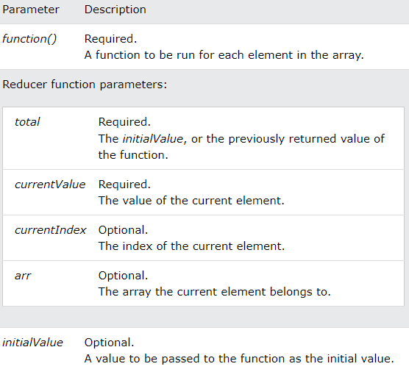
Reduce() parameters

Slide 65
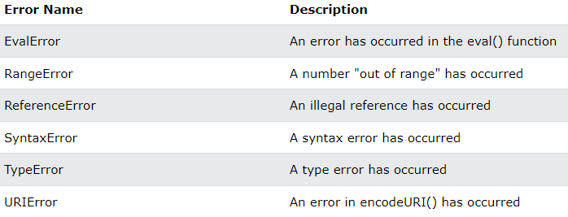
Javascript errors
Six different values can be returned by the error name property:

Slide 66
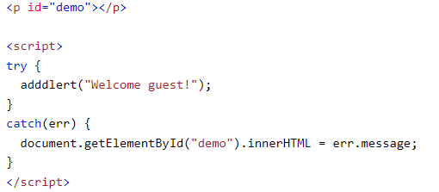
Exception Handling (Throw, and Try...Catch...Finally)
The trycatch statement defines a code block to handle any error.
The finally statement defines a code block to run regardless of the result.
The throw statement defines statement defines a code block to run (to try).
The a custom error.

Slide 67
JavaScript DOM & DOM manipulation

Slide 68
Browser Object Model (BOM)
There are no official standards for the Browser Object Model (BOM).
Since modern browsers have implemented (almost) the same methods and properties for JavaScript interactivity, it is often referred to, as methods and properties of the BOM.

Slide 69
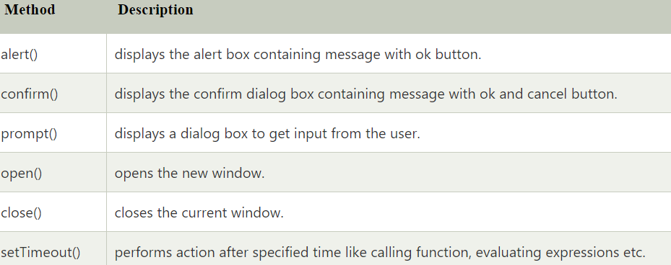
Window Object
The window object represents an open window in a browser.
If a document contain frames (<iframe> tags), the browser creates one window object for the HTML document, and one additional window object for each frame.
The important methods of window object are as follows:

Slide 70

Window Size
Two properties can be used to determine the size of the browser window.
Both properties return the sizes in pixels:
window.innerHeight - the inner height of the browser window (in pixels)
window.innerWidth - the inner width of the browser window (in pixels)

Slide 71
JavaScript Window Screen
The window.screen object contains information about the user's screen.
Properties:
screen.width
screen.height
screen.availWidth
screen.availHeight
screen.colorDepth
screen.pixelDepth
Notes:
Window Screen Width
The screen.width property returns the width of the visitor's screen in pixels.
document.getElementById("demo").innerHTML = "Screen Width: " + screen.width;
Window Screen Height
The screen.height property returns the height of the visitor's screen in pixels.
document.getElementById("demo").innerHTML = "Screen Height: " + screen.height;
Window Screen Available Width
The screen.availWidth property returns the width of the visitor's screen, in pixels, minus interface features like the Windows Taskbar.
document.getElementById("demo").innerHTML = "Available Screen Width: " + screen.availWidth;
Window Screen Available Height
The screen.availHeight property returns the height of the visitor's screen, in pixels, minus interface features like the Windows Taskbar.
document.getElementById("demo").innerHTML = "Available Screen Height: " + screen.availHeight;
Window Screen Color Depth
The screen.colorDepth property returns the number of bits used to display one color.
All modern computers use 24 bit or 32 bit hardware for color resolution:
24 bits = 16,777,216 different "True Colors"
32 bits = 4,294,967,296 different "Deep Colors"
Older computers used 16 bits: 65,536 different "High Colors" resolution.
Very old computers, and old cell phones used 8 bits: 256 different "VGA colors".
document.getElementById("demo").innerHTML = "Screen Color Depth: " + screen.colorDepth;

Slide 72
JavaScript Window Location
The window.location object can be used to get the current page address (URL) and to redirect the browser to a new page.
The window.location object can be written without the window prefix.
Some examples:
window.location.href returns the href (URL) of the current page
window.location.hostname returns the domain name of the web host
window.location.pathname returns the path and filename of the current page
window.location.protocol returns the web protocol used (http: or https:)
window.location.assign() loads a new document

Slide 73

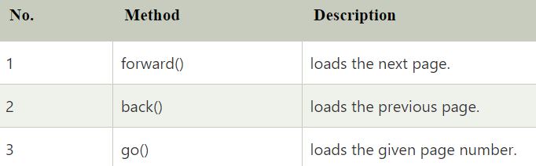

JavaScript History Object
The JavaScript history object represents an array of URLs visited by the user. By using this object, you can load previous, forward or any particular page.
The history object is the window property, so it can be accessed by:
Or just
Important Methods:

Slide 74
Console Object
The console object provides access to the browser's debugging console.
The console object is a property of the window object.
The console object is accessed with:
window.console or just console

Slide 75
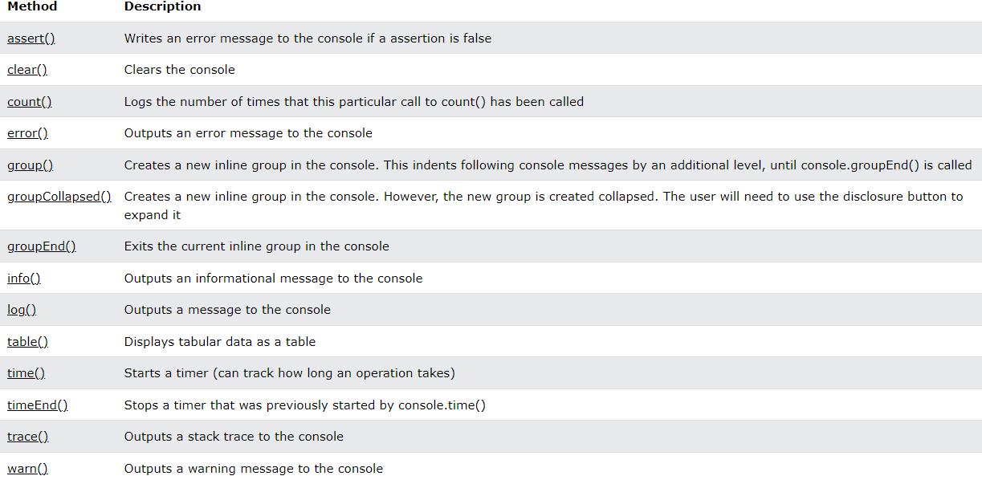
Console object methods

Slide 76

The HTML DOM (Document Object Model)
When a web page is loaded, the browser creates a Document Object Model of the page.
The HTML DOM model is constructed as a tree of Objects:
Notes:
DOM vs BOM
The Document Object Model (DOM) defines a standard for accessing documents. The Browser Object Model (BOM) allows JavaScript to "talk to" the browser

Slide 77
Why DOM is important?
With the object model, JavaScript gets all the power it needs to create dynamic HTML:
JavaScript can change all the HTML elements in the page
JavaScript can change all the HTML attributes in the page
JavaScript can change all the CSS styles in the page
JavaScript can remove existing HTML elements and attributes
JavaScript can add new HTML elements and attributes
JavaScript can react to all existing HTML events in the page
JavaScript can create new HTML events in the page

Slide 78
What is DOM?
The DOM is a W3C (World Wide Web Consortium) standard.
The DOM defines a standard for accessing documents:
"The W3C Document Object Model (DOM) is a platform and language-neutral interface that allows programs and scripts to dynamically access and update the content, structure, and style of a document."
The W3C DOM standard is separated into 3 different parts:
Core DOM - standard model for all document types
XML DOM - standard model for XML documents
HTML DOM - standard model for HTML documents

Slide 79
What is DOM?
The HTML DOM is a standard object model and programming interface for HTML. It defines:
The HTML elements as objects
The properties of all HTML elements
The methods to access all HTML elements
The events for all HTML elements
In other words: The HTML DOM is a standard for how to get, change, add, or delete HTML elements.

Slide 80
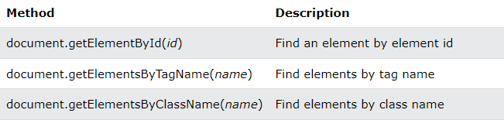
Access Elements in the DOM
The document object represents your web page.
If you want to access any element in an HTML page, you always start with accessing the document object.
Below are some examples of how you can use the document object to access and manipulate HTML.

Slide 81
QuerySelector
The querySelector() method returns the first element that matches a CSS selector.
To return all matches (not only the first), use the querySelectorAll() instead.
Both querySelector() and querySelectorAll() throw a SYNTAX_ERR exception if the selector(s) is invalid.

Slide 82
QuerySelectorAll()
It is same just like querySelector, it just returns all the elements matching with the query.

Slide 83

getElementById()
The getElementById() method returns an element with a specified value.
The getElementById() method returns null if the element does not exist.
The getElementById() method is one of the most common methods in the HTML DOM. It is used almost every time you want to read or edit an HTML element.

Slide 84

getElementsByClassName()
The getElementsByClassName() method returns a collection of elements with a specified class name(s).
The getElementsByClassName() method returns an HTMLCollection.
The getElementsByClassName() property is read-only.

Slide 85

getElementsByTagName
The getElementsByTagName() method returns a collection of all elements with a specified tag name.
The getElementsByTagName() method returns an HTMLCollection.
The getElementsByTagName() property is read-only.
Notes:
Here are some common use cases for both `HTMLCollection` and `NodeList`, which demonstrate when and why you might use each of these collections in real-world scenarios.
### Use Cases for `HTMLCollection`
1. **Dynamically updating a list of elements**
- **Use Case**: Suppose you’re creating a shopping cart where items can be dynamically added or removed. You want a live collection that always reflects the current list of items in the cart.
- **Example**: Using `getElementsByClassName()` to get a live `HTMLCollection` of all cart items. This way, every time a new item is added, the collection updates without needing to re-query the DOM.
```javascript
let cartItems = document.getElementsByClassName("cart-item");
console.log(cartItems.length); // Reflects the current number of items
// Add new item to cart
let newItem = document.createElement("div");
newItem.className = "cart-item";
document.body.appendChild(newItem);
console.log(cartItems.length); // Updates automatically
```
2. **Manipulating a group of form fields**
- **Use Case**: In a form with multiple input fields, you might need to validate or update all fields with a certain class, like `required`.
- **Example**: Using `getElementsByClassName("required")` provides a live collection, so if new required fields are added dynamically (e.g., through JavaScript), they’re included automatically.
```javascript
let requiredFields = document.getElementsByClassName("required");
// Example: Adding a new required field dynamically
let newInput = document.createElement("input");
newInput.className = "required";
document.body.appendChild(newInput);
console.log(requiredFields.length); // Reflects the updated number of required fields
```
3. **Managing dynamic UI components like tabs**
- **Use Case**: Imagine a tabbed UI where each tab has the same class (`tab`). If a new tab is added or removed, you want the list to stay updated.
- **Example**: Using `getElementsByClassName("tab")` gives a live collection of tabs that will automatically update as new tabs are added or removed.
---
### Use Cases for `NodeList`
1. **One-time query of static elements**
- **Use Case**: If you’re styling a set of elements when the page loads but don’t expect to add or remove those elements, a `NodeList` is a good choice since it won’t need to update.
- **Example**: Using `querySelectorAll("p")` to get all paragraph elements for initial styling.
```javascript
let paragraphs = document.querySelectorAll("p");
paragraphs.forEach(p => p.style.color = "blue"); // Applies a style to all <p> elements once
```
2. **Event delegation for static collections**
- **Use Case**: Suppose you want to set up click listeners on multiple buttons or elements only once, without needing the collection to update dynamically.
- **Example**: Using `querySelectorAll("button")` to get a `NodeList` of buttons and attaching event listeners.
```javascript
let buttons = document.querySelectorAll("button");
buttons.forEach(button => {
button.addEventListener("click", () => alert("Button clicked!"));
});
```
3. **Selecting mixed content like text and element nodes**
- **Use Case**: In cases where you need access to both text and element nodes, such as iterating over nodes in a container and handling text separately from elements, `childNodes` (which returns a live `NodeList`) is useful.
- **Example**: Using `childNodes` on an element with both text and child elements.
```javascript
let container = document.getElementById("container");
let nodes = container.childNodes; // Returns a live NodeList with text and element nodes
nodes.forEach(node => {
if (node.nodeType === Node.TEXT_NODE) {
console.log("Text:", node.textContent.trim());
} else {
console.log("Element:", node.tagName);
}
});
```
4. **Accessing elements with complex CSS selectors**
- **Use Case**: If you want to select elements using a complex CSS selector (e.g., selecting nested or combined elements), `querySelectorAll` returns a static `NodeList`.
- **Example**: Using `querySelectorAll(".menu li a")` to get all links within a list inside a `.menu` element.
```javascript
let menuLinks = document.querySelectorAll(".menu li a");
menuLinks.forEach(link => link.style.color = "green");
```
---
### Summary of When to Use Each
- **Use `HTMLCollection`** for live collections where you expect the DOM to change, and you want the collection to reflect those changes.
- **Use `NodeList`** for static or complex selections where the initial collection is enough, or you need a mixture of node types (text and element nodes).
Let me know if you have further questions on any of these examples!

Slide 86
The Difference Between an HTMLCollection and a NodeList
A NodeList and an HTMLcollection is very much the same thing.
Both are array-like collections (lists) of nodes (elements) extracted from a document. The nodes can be accessed by index numbers. The index starts at 0.
Both have a length property that returns the number of elements in the list (collection).
An HTMLCollection is a collection of document elements.
A NodeList is a collection of document nodes (element nodes, attribute nodes, and text nodes).
HTMLCollection items can be accessed by their name, id, or index number.
NodeList items can only be accessed by their index number.
An HTMLCollection is always a live collection. Example: If you add a <li> element to a list in the DOM, the list in the HTMLCollection will also change.
A NodeList is most often a static collection. Example: If you add a <li> element to a list in the DOM, the list in NodeList will not change.
The getElementsByClassName() and getElementsByTagName() methods return a live HTMLCollection.
The querySelectorAll() method returns a static NodeList.
The childNodes property returns a live NodeList.
Notes:
Sure! Let's go through the "who, what, where, when, why, and how" questions about `NodeList` and `HTMLCollection` to understand how to use them and why they’re useful. I'll also provide beginner-friendly examples.
### 1. **What are `NodeList` and `HTMLCollection`?**
- **`NodeList`** and **`HTMLCollection`** are *array-like* objects in JavaScript that represent collections of DOM nodes.
- **`HTMLCollection`**: A collection of HTML elements only, so it includes only element nodes.
- **`NodeList`**: A collection of all types of nodes, including element nodes, text nodes, and attribute nodes, depending on what created the list.
### 2. **Where do `NodeList` and `HTMLCollection` come from?**
- **`NodeList`**: Commonly returned by methods like `document.querySelectorAll()` and properties like `childNodes`.
- **`HTMLCollection`**: Commonly returned by methods like `document.getElementsByClassName()` and `document.getElementsByTagName()`.
### 3. **When do `NodeList` and `HTMLCollection` update?**
- **`HTMLCollection`**: Always updates automatically (live collection). If the DOM changes, the `HTMLCollection` reflects those changes immediately.
- **`NodeList`**: Usually static (doesn’t update automatically), except for certain properties like `childNodes`, which return a live `NodeList`.
### 4. **Why are `NodeList` and `HTMLCollection` used?**
- They make it easy to *group* and *work with multiple DOM elements or nodes* in a structured way. They allow you to loop over or manipulate multiple elements at once.
- **Use `HTMLCollection`** when you need a live list that updates with the DOM.
- **Use `NodeList`** when you need a static list or want to work with nodes other than elements.
### 5. **How to access elements in `NodeList` and `HTMLCollection`?**
- Access items by index, like an array: `list[0]`, `list[1]`, etc.
- `HTMLCollection` items can also be accessed by `name` or `id`.
---
### Examples
#### Example of an `HTMLCollection`
```html
<!DOCTYPE html>
<html>
<body>
<div class="box">Box 1</div>
<div class="box">Box 2</div>
<div class="box">Box 3</div>
<script>
// Selecting elements with class 'box' returns an HTMLCollection
let boxes = document.getElementsByClassName("box");
// Accessing each box by index
console.log(boxes[0].innerText); // Output: Box 1
console.log(boxes[1].innerText); // Output: Box 2
// This collection is live. If a new .box element is added to the DOM, boxes will update.
let newDiv = document.createElement("div");
newDiv.className = "box";
newDiv.innerText = "Box 4";
document.body.appendChild(newDiv);
console.log(boxes.length); // Output: 4
</script>
</body>
</html>
```
#### Example of a `NodeList`
```html
<!DOCTYPE html>
<html>
<body>
<p>This is a paragraph.</p>
<p>This is another paragraph.</p>
<script>
// Selecting all <p> elements returns a NodeList
let paragraphs = document.querySelectorAll("p");
// Accessing each paragraph by index
console.log(paragraphs[0].innerText); // Output: This is a paragraph.
console.log(paragraphs[1].innerText); // Output: This is another paragraph.
// This NodeList is static. Adding a new <p> element does not change 'paragraphs'
let newParagraph = document.createElement("p");
newParagraph.innerText = "This is a new paragraph.";
document.body.appendChild(newParagraph);
console.log(paragraphs.length); // Output: 2 (it doesn’t change even though there's a new <p>)
</script>
</body>
</html>
```
---
### Summary
- Use `HTMLCollection` when you need a live collection that reflects changes in the DOM.
- Use `NodeList` when you want a static list of nodes (often with `querySelectorAll`).
These objects help you manipulate multiple DOM elements efficiently, making your JavaScript code more dynamic and interactive.

Slide 87
DOM - Manipulation

Slide 88
Node vs Element
Node: it is the name of any type of object in the DOM tree. It could be one of the built-in DOM elements such as the document itself, document.head or document.body.
A node could be an HTML tag specified in the HTML such as <input>, <div>,<h2>, <p> or it could be a comment node, text node…
A node is any DOM object and every node has a parent, every node is allowed to have one or more children or even zero children
An element is a specific type of node, one that can be directly specified in the HTML with an HTML tag and can have properties like an id or a class.

Slide 89
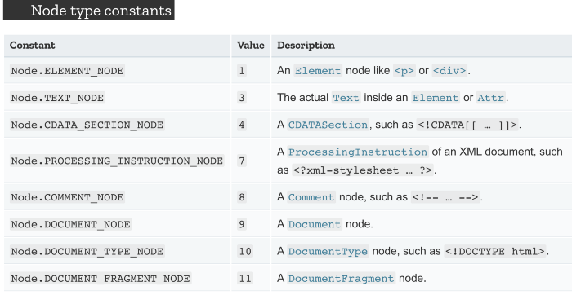
Type of Nodes

Slide 90
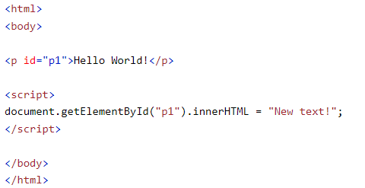
Changing HTML Content
The easiest way to modify the content of an HTML element is by using the innerHTML property.
To change the content of an HTML element, use this syntax:

Slide 91
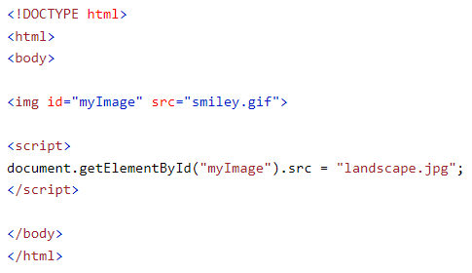
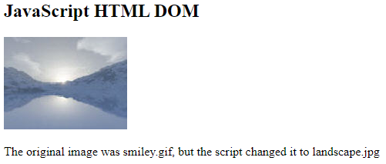
Changing the Value of an Attribute
To change the value of an HTML attribute, use this syntax:

Slide 92
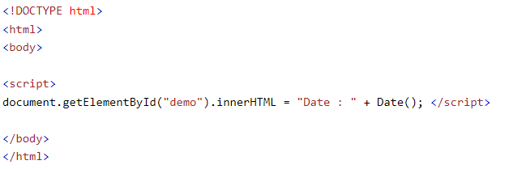

Dynamic HTML content
JavaScript can create dynamic HTML content:

Slide 93
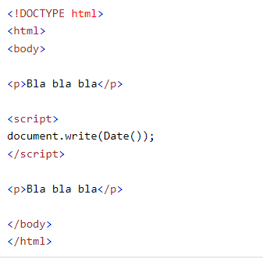
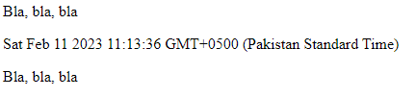
document.write()
In JavaScript, document.write() can be used to write directly to the HTML output stream:

Slide 94
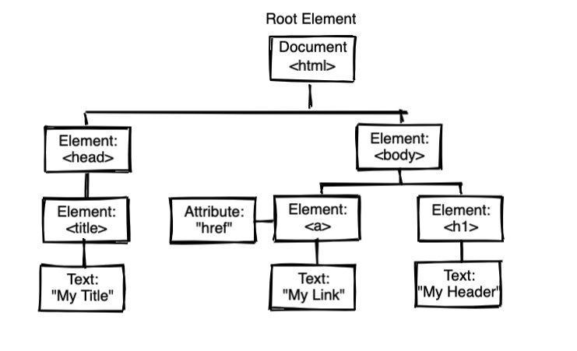
DOM Traversing
As we already know according to the W3C HTML DOM standard “everything in an HTML document is a node:”

Slide 95
DOM Explained
The entire document is a document node
Every HTML element is an element node
The text inside HTML elements are text nodes
All comments are comment nodes

Slide 96
Node Relationships
The nodes in the node tree have a hierarchical relationship to each other. The terms parent, child, and sibling are used to describe the relationships.
In a node tree, the top node is called the root (or root node)
Every node has exactly one parent, except the root (which has no parent)
A node can have a number of children
Siblings (brothers or sisters) are nodes with the same parent

Slide 97
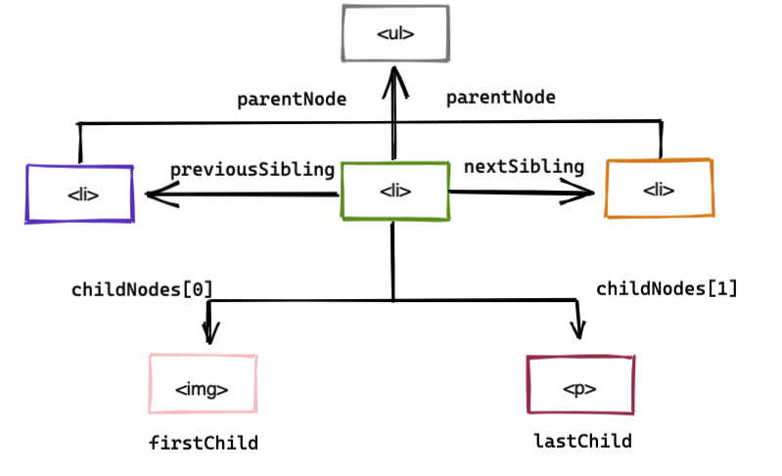
Navigating Between Nodes

Slide 98

Traversal Methods
Consider the following code example:
parent-1, parent-2 belongs to grandparent
child-1, child-2 belongs to parent-1
child-3, child-4 belongs to parent-2
We can traverse in three directions:
Downwards
Sideways
Upwards
Notes:
You can traverse in three directions:
Downwards
Sideways
Upwards
1. Traversing downwards
There are two methods to traverse downwards:
i. querySelector or querySelectorAll
ii. children
2. Traversing upwards
There are two methods to traverse upwards:
i. parentElement
ii. closest
3. Traversing sideways
There are three methods to traverse sideways:
i. nextElementSibling
ii. previousElementSibling
ii.i Combining parentElement, children, and index.

Slide 99

1. getElementById
This one is a classic, find a single element node by targeting the id

Slide 100

2. getElementsByClassName
This is our second classic way to select multiple elements at once, let’s say to target both our parent divs

Slide 101

3. querySelector
A lot easier to use a single method to target classes or ids

Slide 102

4. querySelectorAll
Similar to querySelector but used to select multiple element nodes

Slide 103

5. parentElement
Used to target one level up the DOM tree to target the parent node

Slide 104

6. previousElementSibling
Used to target one node to the left in terms of DOM tree

Slide 105

7. nextElementSibling
Used to target one node to the right in terms of DOM tree

Slide 106

8.firstElementChild
Used to target the first node down the DOM tree

Slide 107

9. lastElementChild
Used to target the last node down the DOM tree

Slide 108

10. childNodes[node #]
Last on my list but another one of my favorites, the childNodes method takes in a number to target child nodes of a parent

Slide 109

Creating New HTML Elements (Nodes)
To add a new element to the HTML DOM, you must create the element (element node) first, and then append it to an existing element.

Slide 110

Creating new HTML Elements - insertBefore()
The appendChild() method in the previous example, appended the new element as the last child of the parent.
If you don't want that you can use the insertBefore() method:

Slide 111

Creating New Nodes
The createElement() and createTextNode() methods are used to create new nodes in the DOM.

Slide 112

createElement() & createTextNode()

Slide 113

Inserting Nodes into the DOM

Slide 114




Example
To add new nodes

Slide 115




Replace Nodes
Replacing nodes:

Slide 116

Removing Nodes from the DOM

Slide 117


Example

Slide 118
Browser Events
An HTML event can be something the browser does, or something a user does.
Here are some examples of HTML events:
An HTML web page has finished loading
An HTML input field was changed
An HTML button was clicked
Often, when events happen, you may want to do something.
JavaScript lets you execute code when events are detected.
HTML allows event handler attributes, with JavaScript code, to be added to HTML elements.

Slide 119

Common HTML Events

Slide 120
JavaScript Event Handlers
Event handlers can be used to handle and verify user input, user actions, and browser actions:
Things that should be done every time a page loads
Things that should be done when the page is closed
Action that should be performed when a user clicks a button
Content that should be verified when a user inputs data
Many different methods can be used to let JavaScript work with events:
HTML event attributes can execute JavaScript code directly
HTML event attributes can call JavaScript functions
You can assign your own event handler functions to HTML elements
You can prevent events from being sent or being handled

Slide 121
Adding Event Listeners
You can add an event listener to an element using the addEventListener() method

Slide 122
Removing Event Listeners
You can remove an event listener using the removeEventListener() method

Slide 123

The load event in the window object
The load event in the window object waits until the DOM is fully loaded like all the resources including the images, iframes, etc is loaded.
The load event is triggered after everything on a page is loaded.

Slide 124

The DOMContentLoaded event in the document object

Slide 125
DOMContentLoaded vs Load
The DOMContentLoaded event is fired when the document has been completely loaded and parsed, without waiting for stylesheets, images, and subframes to finish loading (the load event can be used to detect a fully-loaded page).

Slide 126

The Event Object
All event objects in the HTML DOM are based on the Event Object.
All event objects (like MouseEvent and KeyboardEvent) has access to the Event Object's properties and methods.
And many more events…..

Slide 127

Event Properties and Methods
Notes:
Event bubbling is a type of DOM event propagation where the event first triggers on the innermost target element, and then successively triggers on the ancestors of the target element in the same nesting hierarchy till it reaches the outermost DOM element or document object

Slide 128

Event Target property
The target property returns the element where the event occured.
The target property is read-only.
The target property returns the element on which the event occurred, opposed to the currentTarget property, which returns the element whose event listener triggered the event.
Get the element where the event occurred:

Slide 129
Javascript Local Storage

Slide 130




localstorage
The localStorage object allows you to save key/value pairs in the browser.
Syntax:
Save Data to Local Storage Remove Data from Local Storage
Read Data from Local Storage Remove All data

Slide 131

Example

Slide 132

Cookie
Cookies are data, stored in small text files, on your computer.
When a web server has sent a web page to a browser, the connection is shut down, and the server forgets everything about the user.
Cookies were invented to solve the problem "how to remember information about the user":
When a user visits a web page, his/her name can be stored in a cookie.
Next time the user visits the page, the cookie "remembers" his/her name.
Cookies are saved in name-value pairs like:

Slide 133
Create a Cookie with JavaScript
JavaScript can create, read, and delete cookies with the document.cookie property.
We can also add an expiry date (in UTC time). By default, the cookie is deleted when the browser is closed:
With a path parameter, you can tell the browser what path the cookie belongs to. By default, the cookie belongs to the current page.

Slide 134

Read a Cookie
With JavaScript, cookies can be read like this:

Slide 135
Change a Cookie
With JavaScript, you can change a cookie the same way as you create it:

Slide 136

Delete a Cookie
Deleting a cookie is very simple.
You don't have to specify a cookie value when you delete a cookie.
Just set the expires parameter to a past date:

Slide 137
The Cookie String
The document.cookie property looks like a normal text string. But it is not.
Even if you write a whole cookie string to document.cookie, when you read it out again, you can only see the name-value pair of it.
If you set a new cookie, older cookies are not overwritten. The new cookie is added to document.cookie, so if you read document.cookie again you will get something like:
cookie1 = value; cookie2 = value;

Slide 138
Cookies vs LocalStorage
Cookies are intended to be read by the server, whereas localStorage can only be read by the browser.
cookies are restricted to small data volumes, while localStorage can store more data.
localStorage is an implementation of the Storage Interface. It stores data with no expiration date, and gets cleared only through JavaScript, or clearing the Browser Cache / Locally Stored Data — unlike cookie expiry .

Slide 139
Web Working?

Slide 140

How web works?

Slide 141
How web works?
The basis of the web is asking for and receiving information. The 'asker' in this case is a client and the 'provider' is a server.
The messages sent by the client, usually a Web browser, are called requests and the messages sent by the server as an answer are called responses.

Slide 142
Client?
A client is a piece of computer hardware or software that connects to and accesses the resources of a remote computer, or server.
In the web development world, clients are web browsers (like Chrome, Firefox, Safari), but clients can also be API’s making requests to another server or the command line (when making cURL, telnet requests)

Slide 143
Server?
A server is a piece of computer hardware or software that provides resources, data, services, or functionality for other programs or devices, called clients.

Slide 144
HTTP?
HTTP (HyperText Transfer Protocol) is a protocol for fetching resources such as HTML documents, images, videos, scripts, and more.
HTTP is responsible for communication between web servers and clients. Every time you visit a webpage, submit a form, click a button, you make a request and get back a response.

Slide 145
HTTP is stateless?
This means that every request is completely independent, there is no link between two requests successively carried out on the same connection.
That said, with programming, local storage, cookies, and sessions we can create enhanced user experiences that use stateful sessions.

Slide 146
HTTPS
Hypertext Transfer Protocol Secure (HTTPS) is an extension of the Hypertext Transfer Protocol (HTTP).
It is used for secure communication over a computer network and is widely used on the Internet.
In HTTPS, the communication protocol is encrypted using Transport Layer Security (TLS) or, formerly, Secure Sockets Layer (SSL).

Slide 147
HTTP Request?
When a client (like a web browser) retrieves information, it sends a payload of data to a server as a request. This request is made up of three main parts:
A Request line, containing three pieces of information:
the HTTP verb (also called an HTTP method) for sending or retrieving information
the URI path of the resource where we’re sending or retrieving information
the version of the HTTP protocol our “client” software is using, usually HTTP/1.1
Headers, which are key/value pairs, which contain supplemental information about our request
An optional body; we only send data to the server in the body when we are creating or modifying something

Slide 148
HTTP Response?
When a server or web application is finished processing a request, it sends a response which is a payload of data, back to the client. This response contains three main parts:
a status line, containing three pieces of information:
The version of the HTTP protocol that this response is using
a 3-digit numeric “status code”.
a user-friendly string description of what the “status code” means
Headers, also sent as key/value pairs similar to the HTTP request
An optional body; almost all responses will contain additional data in the body.

Slide 149
HTTP Methods?
How the user wants to interact with the resource is communicated through the request method.
Below are the primary or most commonly-used HTTP methods. These methods correspond to create, read, update, and delete (or CRUD) operations, respectively. There are several other methods, too, but they are utilized less frequently.
GET - retrieve some information to be READ by the client/user
POST - CREATE a new resource with the information contained in the request
PUT - UPDATE an entire resource with the information contained in the request
PATCH - UPDATE a part of a resource with the information contained in the request
DELETE - DESTROY a resource, typically indicating that it is removed from the database

Slide 150
Request / Response Cycle
Flow as executed by computers:
You open your browser, the client, and type in a web address like http://davisgitonga.dev and hit enter.
The browser takes this address and builds an HTTP Request. It addresses it to the server located at http://davisgitonga.dev.
The request is handed off to your Internet Service Provider (ISP) and sent through the internet, mostly a series of wires and fiber optic cables, to a server.
The server reads the request. It knows how to read it because it is formatted as an HTTP Request.
The server generates an HTTP Response to that request.
The server hands the response off to their ISP which goes through the internet to arrive at your computer.
Your browser reads the response. It knows how to read it because it is formatted as an HTTP Response.
Your browser displays the data on your machine.

